Slide 1


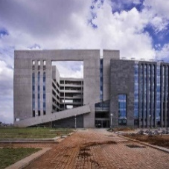

Finite Element Methods Lab
Laser Forming
Dept. of Mechanical & Aerospace Engineering, IIT Hyderabad
Course Instructor: Dr. Muvvala Gopinath
BARATH.I
ME25MTECH11002
Department of Mechanical & Aerospace Engineering, IIT Hyderabad
0

Slide 2
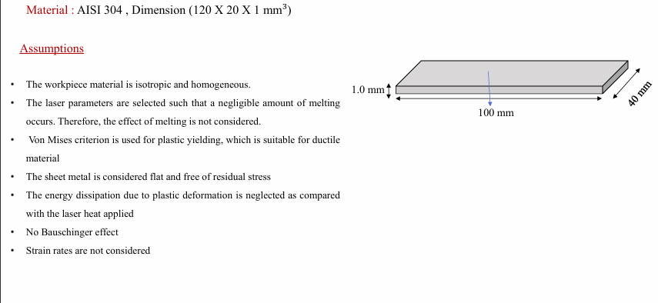
Department of Mechanical & Aerospace Engineering, IIT Hyderabad

Slide 3
Young's modulus (N/m²) | Poission Ratio | Temperature (K)
1.94E+11 | 0.27 | 277
1.84E+11 | 0.28 | 466
1.68E+11 | 0.3 | 686
1.3E+11 | 0.33 | 1080
73000000000 | 0.34 | 1281
2000000000 | 0.34 | 1430
 | Yield stess (N/m²) | Strain | Temperature (K)
 | 293000000 | 0 | 343
 | 336200000 | 0.03 | 343
 | 250000000 | 0 | 373
 | 294400000 | 0.03 | 373
 | 210000000 | 0 | 473
 | 255000000 | 0.03 | 473
 | 181000000 | 0 | 573
 | 225100000 | 0.03 | 573
 | 157000000 | 0 | 723
 | 198400000 | 0.03 | 723
 | 147000000 | 0 | 873
 | 192300000 | 0.03 | 873
 | 129000000 | 0 | 1073
 | 153990000 | 0.03 | 1073
 | 48000000 | 0 | 1273
 | 67200000 | 0.03 | 1273
Expansion (/K) | Temperature (K)
1.60E-05 | 297
1.70E-05 | 421
1.90E-05 | 740
2.00E-05 | 900
2.10E-05 | 1072
2.30E-05 | 1266
Conductivity (W/mK) | Temperature (K)
15 | 277
17 | 419
21 | 738
28 | 1277
28 | 1619
 | Sp.Heat (J/KgK) | Temperature (K)
 | 481 | 295
 | 505 | 350
 | 529 | 489
 | 576 | 771
 | 631 | 1098
 | 656 | 1190
 | 669 | 1256
 | 689 | 1516
 | 701 | 1741
Density (Kg/m³) | Temperature (K)
7900 | 295
7848 | 377
7799 | 517
7598 | 1077
7401 | 1347
7213 | 1610
Department of Mechanical & Aerospace Engineering, IIT Hyderabad

Slide 4
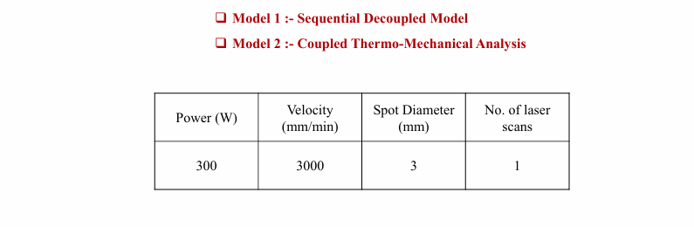
LASER PARAMERETS
Department of Mechanical & Aerospace Engineering, IIT Hyderabad

Slide 5
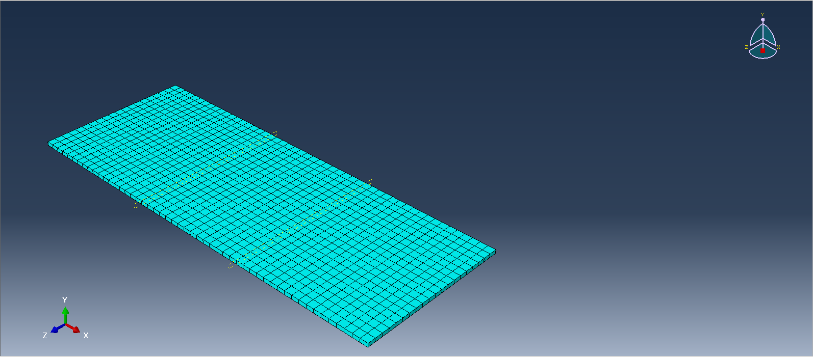
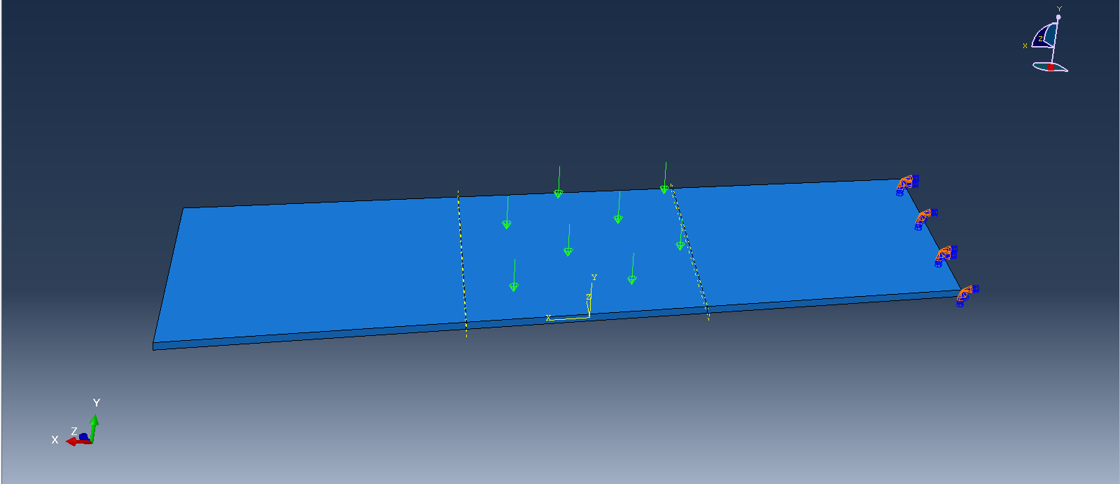
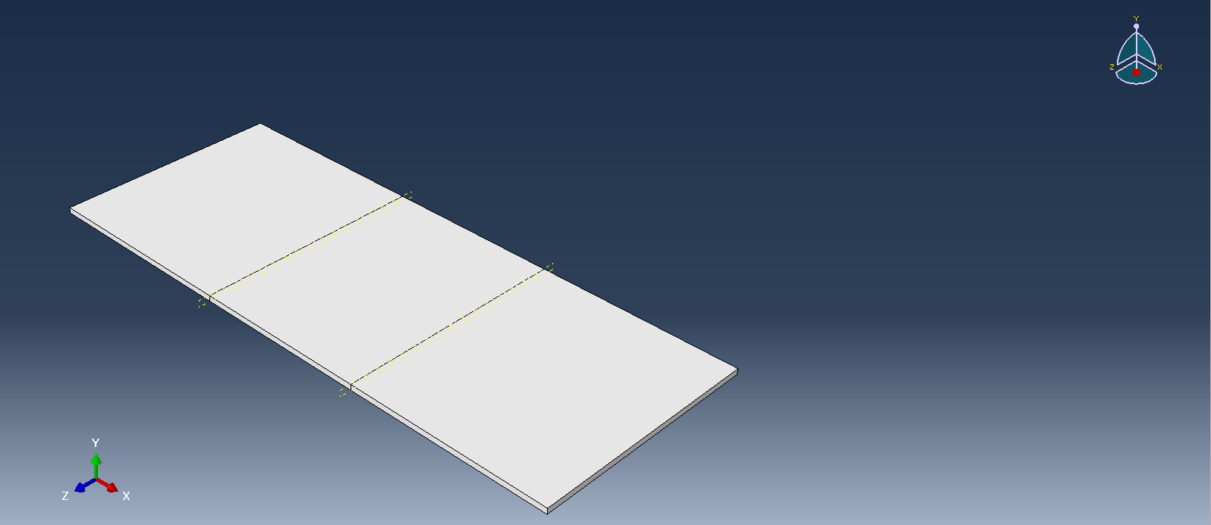
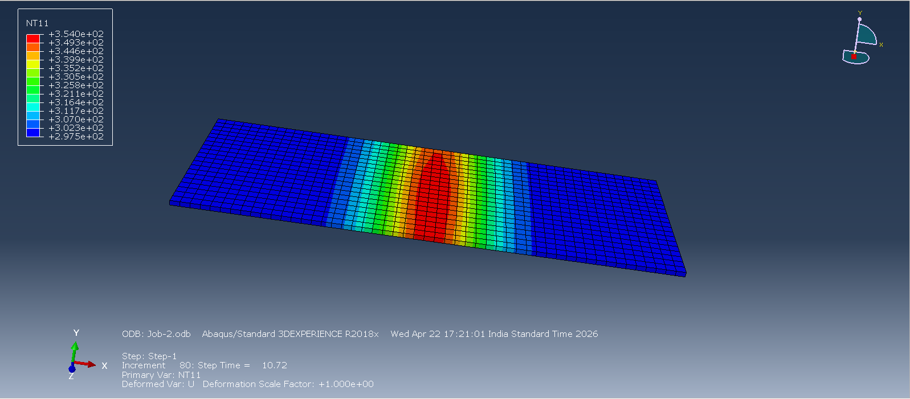
MESHING
LOADING
PARTITION
TEMPERATURE DISTRIBUTION
Department of Mechanical & Aerospace Engineering, IIT Hyderabad

Slide 6
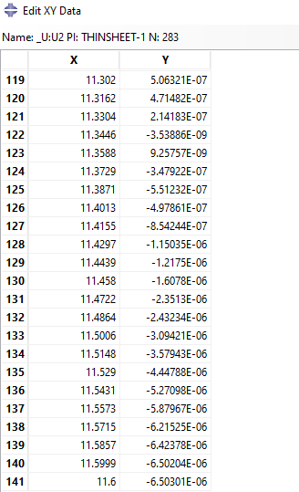
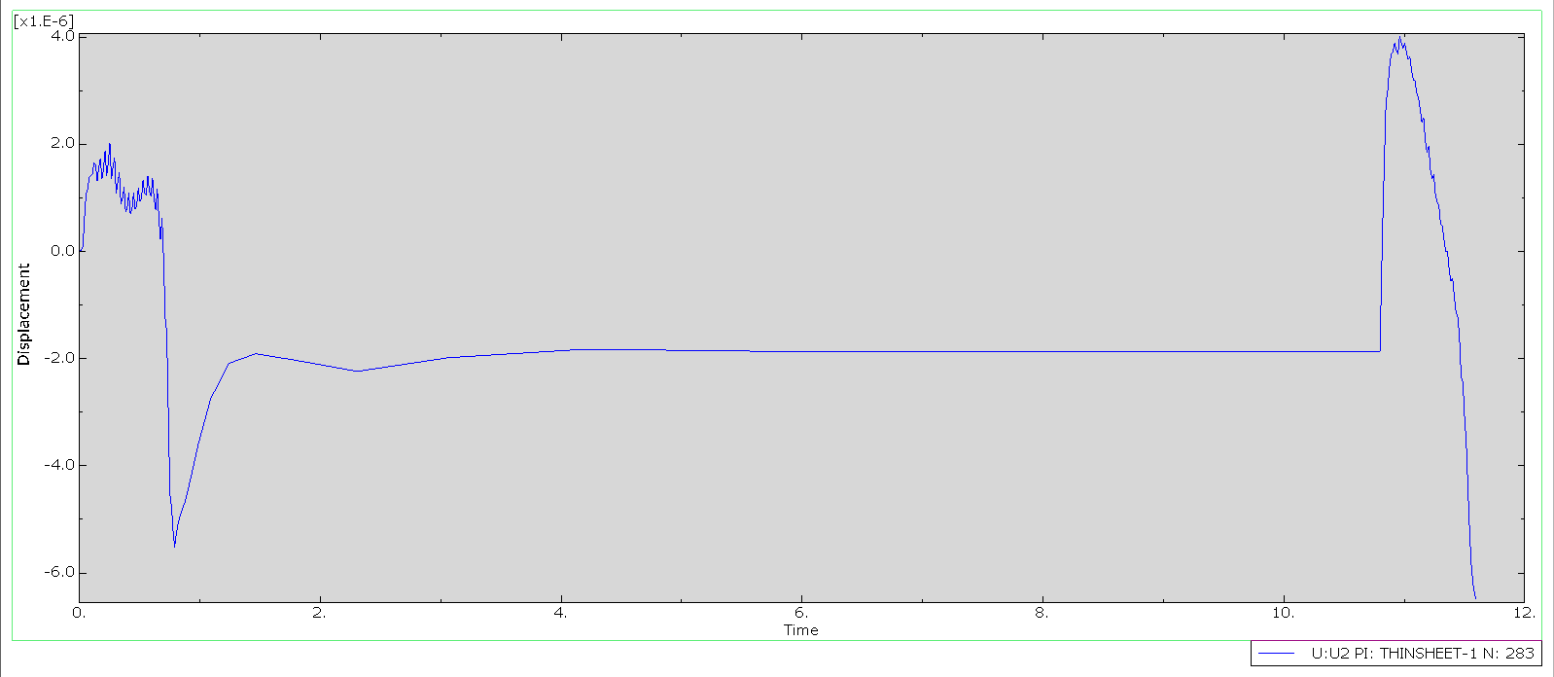
BENDING ANGLE CALCULATION
Initial stage → thermal expansion
Sudden drop → plastic deformation starts
Plateau → residual bending achieved
Final stage → cooling completes deformation
Department of Mechanical & Aerospace Engineering, IIT Hyderabad

Slide 7


DISPLACEMENT
LENGTH

Slide 8
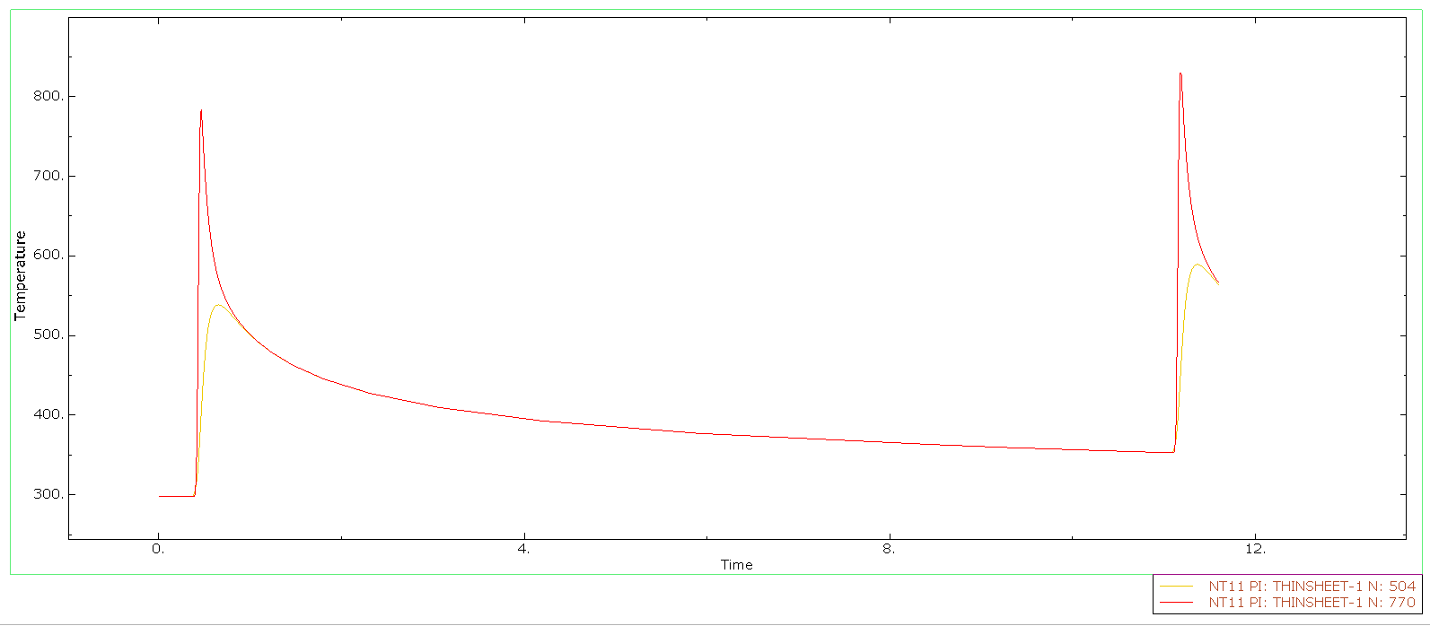
TEMPERATURE VS TIME
Initial temperature ≈ 300 K (room temperature)
First peak temperature ≈ 780–800 K
Second peak temperature ≈ 820–840 K
Cooling region stabilizes around 350–400 K
Temperature rise is very sharp (transient heating)
Department of Mechanical & Aerospace Engineering, IIT Hyderabad

Slide 9
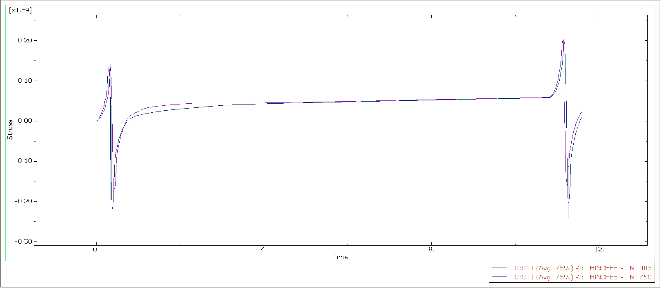
STRESS VS TIME
Top Surface (Laser Side)
Experiences compressive stress during heating
Due to rapid thermal expansion at surface
Converts to tensile stress during cooling
Department of Mechanical & Aerospace Engineering, IIT Hyderabad

Slide 10
CONCLUSION
A laser power of 300 W produces sufficient localized heating to induce controlled plastic deformation in the thin sheet.
The temperature profile shows rapid heating up to ~800–850 K, followed by gradual cooling, confirming a strong thermal gradient through thickness.
This thermal gradient activates the Temperature Gradient Mechanism (TGM), which is the dominant mechanism for bending in thin sheets.
Top surface (laser side):
  Compressive stress during heating
  Tensile stress during cooling
Bottom surface:
  Tensile during heating
  Compressive after cooling
Peak stress values reach approximately ±200–250 MPa, indicating plastic deformation

